Slide 1
AR CANS/FAST TRAINING Arkansas Child and Adolescent Needs and Strengths Family Advocacy and Support Tool
Developed by AR Department of Human Services
Division of Children and Family Services

Slide 2
CANS
Child and Adolescent
Needs and Strengths
FAST
Family Advocacy & Support Tool

Slide 3
Why CANS & FAST?
The CANS/FAST Assessment Model is
evidence-based and
provides a way to track progress
on an individual case level
and a system-wide level.
CANS will help us to identify gaps and successes in services.
CANS will help FSWs to prioritize child/family needs in order to address the most imminent needs first.

Slide 4
Why CANS & FAST?
CANS is being used in Child Welfare agencies in at least 20 states across the country.
Arkansas has benefitted from collaborating with other states using the tools to improve successful implementation.
Providers within Arkansas are beginning to use, i.e., Methodist Children’s Homes, DBHS is considering implementing

Slide 5
Arkansas is using CANS as part of the IV-E Waiver
A Waiver is a “demonstration” project allowing states to demonstrate how being flexible with funding and shifting resources can achieve better outcomes.
It’s not “new” money but allows states to use current IV-E dollars more flexibly.
The IV-E Waiver is for a 5-year period – goal is for states to use this time to shift resources, implement interventions, and build capacity so that the child welfare system can sustain the interventions at the end of this time period.
The AR DCFS IV-E Waiver began in 2012.

Slide 6
AR DCFS IV-E WAIVER
I.M.P.A.C.T.
Improving
Meaningful
Practice with
Arkansas
Children
Together

Slide 7
AR CANS-FAST History
1st - Identification of an Evidence Based Assessment
2nd - Creation of AR-specific Versions
3rd - Development of an Assessment Informed Case Plan
4th - Statewide Training and Implementation
Pulaski & Miller Counties - October 2014
Statewide - January 2015 and February 2015

Slide 8
What does that mean for families?
The CANS helps Family Service Workers to prioritize or “triage” the families service needs to ensure that the safety/risk factors are addressed first.
When safety/risk factors have been addressed, the Department/court can re-evaluate the family situation and determine if the child can safely be returned while the Department continues to work with family.

Slide 9
What does that mean for families?
The FAST will provide a more in-depth look at our in-home cases
ensure that we are addressing family needs
NOT “putting a band aid” on the problem or only addressing the specific reason the case is open (i.e. the ‘true finding’).
Prevent families having repeat/multiple involvement with DCFS and prevent children from eventually entering foster care.

Slide 10
ULTIMATE GOAL?
Reduce the number of children in foster care by:
Preventing entry into foster care in the first place (FAST)
Shorten the length of stay in foster care by addressing specific safety factors/high priority needs first (CANS)

Slide 11
Dr. John Lyons – CANS Developer
http://centervideo.forest.usf.edu/cans/CANSTraining.html

Slide 12
CANS-FAST
The purpose of the CANS-FAST is to identify and communicate a shared vision of strengths and needs for children and families across different child servicing system.
The CANS-FAST allows for different parties to communicate the shared vision.
Ratings in a CANS-FAST allow for the creation of a collaborative case plan that is measurable.

Slide 13
CANS-FAST
The CANS-FAST Assessments are outcomes management tools.
In order to manage needs,
we need to be able to measure needs.

Slide 14
AR DCFS Has 3 Child Welfare Assessment Tools
1) AR CANS for Birth – 4 Years
For every child in Foster Care
(Out of Home Placement Cases)
2) AR CANS for Children and Youth 5 Years and Older
For Protective Services
(In Home) Cases
3) AR FAST

Slide 15
What’s in this for me?

Slide 16
CANS-FAST Benefits for a Case Worker
I can use this approach to work smarter rather than harder by avoiding problems ahead of time.
I can better engage families and youth by creating a shared vision where all of our perspectives matter.
I can organize a personalized case plan.
I can measure the progress of children and families based on their specific needs.
I can use a common language with others in the child’s services system.
I can look good to my supervisor and other professionals involved with my cases. ☺

Slide 17
CANS-FAST Benefits for a Parent or Guardian
The CANS-FAST helps parents understand their child and family better.
The CANS-FAST is an approach where the parent’s perspective matters too.
The CANS-FAST helps families agree on what they need to work on together.

Slide 18
Six Key Characteristics
Items are included because they might impact service [case] planning
Level of items translate immediately into action levels
It is about the child not about the service
Consider culture and development
It is agnostic as to etiology (it is not based on the cause)—it is about the ‘what’ not about the ‘why’ (2 exceptions: trauma and child behavior)
The 30 day window is to remind us to keep assessments relevant and ‘fresh’

Slide 19
Action Levels
(Ratings)
0 – No Evidence
1 – Watch/Prevent
2 – Action Needed
3 – Immediate/Intensive
Action
0 – Centerpiece
1 – Useful Strength
2 – Potential Strength
3 – None Identified
(There is a strength)
Needs
Strengths

Slide 20
Action Levels
0 – No Evidence
1 – Watch/Prevent
2 – Action Needed
3 – Immediate/Intensive Action
0 – Centerpiece
1 – Useful Strength
2 – Potential Strength
3 – None Identified
TIP: A “0” is always good.
Needs
Strengths

Slide 21
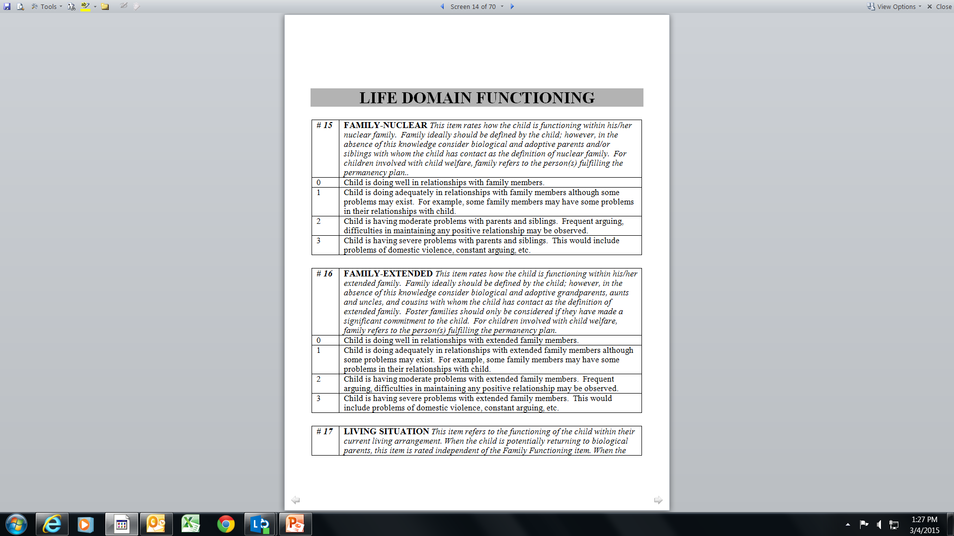
Domain
Item
Action Levels
(Ratings)
Item Definition
Anchor Definitions

Slide 22
AR CANS-FAST
CANS-FAST User Guides And Forms

Slide 23
Child Strengths
Family-Nuclear
Family-Extended
Interpersonal
Educational
Talents/Interests
Spiritual/Religious
Community Life
Relationship Permanence
Child Involvement with Care
Natural Supports
Adaptability
Building Relationships
Resilience
Resourcefulness

Slide 24
Life Domain Functioning
Family-Nuclear
Family Extended
Living Situation
Sleep
Social Functioning-Peer
Social Functioning-Adult
Sexual Development
Developmental²
Communication
Cultural³
Legal
Medical
Physical Health
Daily Functioning

Slide 25
School
School Behavior
School Achievement
School Attendance
Special Education

Slide 26
Child Behavioral/Emotional Needs
Psychosis
Attachment
Impulsivity/Hyper-activity
Depression
Anxiety
Oppositional
Conduct
Adjustment to Trauma
Anger Control
Substance Use⁴

Slide 27
Child Risk Behaviors
Suicide Risk
Self-Injurious Behavior
Other Self-Harm
Danger to Others
Sexual Aggression
Runaway⁵
Delinquent Behavior
Bullying
Intentional Misbehavior
Aggressive Behavior
Exploited

Slide 28
Trauma
Sexual Abuse
Physical Abuse
Emotional Abuse
Neglect
Medical Trauma
Natural Disaster
Witness to Domestic Violence
Witness to Community Violence
Witness/Victim to Criminal Activity

Slide 29
Permanency Planning - Caregiver Strengths & Needs
Supervision
Parenting Skills
Knowledge of Child
Knowledge of Rights & Responsibilities
Organization
Social Resources
Residential Stability
Empathy with Children
Boundaries
Involvement
Posttraumatic Reactions
If a child is in a temporary placement (foster home, treatment facility, and etc.) the “caregiver” section is not to be rated UNLESS the goal is REUNIFICATION or ADOPTION.

Slide 30
Permanency Planning - Caregiver Strengths & Needs Continued
Knowledge of Family/Child Needs
Knowledge of Service Options
Ability to Listen
Ability to Communicate
Satisfaction with Services Arrangement
Physical Health
Mental Health
Substance Use⁷
Developmental
Accessibility to Child Care Arrangement
Family Stress
Employment/Educational Functioning
Educational Attainment
Legal
Financial Resources
Transportation
Safety
Marital/Partner Violence

Slide 31
Modules for CANS 5+
MODULES Complete any specific module only if indicated on the initial page | ¹Transition Age Module-Triggered by DOB
 | ²Developmental Needs (DD) Module
 | ³Acculturation Module
 | ⁴Substance Use Needs (SUN) Module
 | ⁵Runaway Module
 | ⁶Sexual Abuse Module
 | ⁷Substance User Disorder (SUD) Module-Caregiver
Modules are completed only if selected Items are given a 1, 2, or 3 rating EXCEPT for the “Transition Age Module”…it is automatically triggered based on the child’s date of birth (if 14 yrs or older).

Slide 32
Modules for CANS (0-4)
MODULES Complete any specific module only if indicated on the initial page | ¹Developmental Needs (DD) Module
 | ²Acculturation Module
 | ³Sexual Abuse Module
 | ⁴Substance User Disorder (SUD) Module-Caregiver
Modules are completed only if selected Items are given a 1, 2, or 3 rating .

Slide 33
AR FAST
Family Advocacy and Support Tool

Slide 34
The Family Together
Parental/Caregiver Collaboration
Relationships Among Siblings
Extended Family Relationships
Family Conflict
Family Communication
Family Role Appropriateness
Family Safety
Financial Resources
Residential Stability
Home Maintenance

Slide 35
Caregiver Status
Empathy With Child
Boundaries
Involvement
Supervision
Discipline
Partner Relationships
Vocational Functioning
Mental Health
Alcohol and/or Drug Use
Posttraumatic Reactions
Knowledge of Child
Organization
Physical Health
Developmental
Accessibility to Child Care Services
Family Stress
Educational Attainment
Legal
Transportation
Safety

Slide 36
Caregiver Advocacy
Knowledge of Service Options
Knowledge of Rights & Responsibilities
Ability to Listen
Ability to Communicate
Natural Supports
Satisfaction with Youth’s Living Arrangement
Satisfaction with Youth’s Educational Arrangement
Satisfaction with Services Arrangement

Slide 37
Youth Status
Relationship w/ Bio Mother
Relationship w/ Bio Father
Relationship w/ Primary Caregiver
Relationship with other Adult Family Members
Health Status
Mental Health Status
Adjustment to Trauma
Cognitive Skills
Self-Regulation Skills
Interpersonal Skills
Educational Status

Slide 38
Whodunit?
http://youtu.be/ubNF9QNEQLA

Slide 39
Collaboration and Teamwork
It’s easy to miss what you are not looking for.
The shared vision approach helps us to NOT miss important details when working with our families.
Your assessments will be better if you gather information from multiple sources and use your collaterals.
You don’t have to do the CANS-FAST alone!

Slide 40
Tips When Scoring a CANS-FAST
Understand the meaning of the Item and the Action Levels.
Don’t get bogged down in the individual Anchor Definitions.

Slide 41
Item
Action Levels

Slide 42
Practice Scenario
Difficulties with scenarios and vignettes when scoring – don’t have all the information and cannot get it.
No mention = No evidence

Slide 43
CANS-FAST: Informed Case Planning
Identify CANS-FAST Need items with action levels of 2 or 3.
Identify Need items that may need preventive services with a Watchful status of 1.
Prioritize these needs with child and family to develop short term and long term goals.
Identify action steps that support the short term and long term goals
Collaborate and partner with child and family.

Slide 44
CANS-FAST: Informed Case Planning
Identify CANS-FAST Strength items with a 0 or 1 for strengths-based case planning
Strength items with 2 or 3 are those attributes and skills that can be built.
Identify action steps that support the short term and long term goals
Collaborate and partner with child and family.

Slide 45
CANS-FAST: Informed Case Planning
Collaborate and partner with child and family.

Slide 46
AR Case Plan
Arkansas is the first state to directly link the CANS assessment to the case plan.
There is a section of the new case plan for “additional or court-ordered services,” that we can use for any service that is requested by the court or a party of the case but cannot be directly linked to a CANS-identified need (such as a paternity/DNA test).

Slide 47
CANS Certification
Workers must certify at the 70% level.
Only one person has attempted and NOT certified on the CANS.
(There are over 100,000 people certified on the CANS).
You can make as many attempts as needed to certify.
Users will be required to re-certify annually.

Slide 48
Questions & Answers
Brooke Harris, CANS/FAST Program Manager
Office: (501) 682-8439
Cell: (501) 412-9883
Fax: (501) 683-1201
Brooke.Harris@dhs.arkansas.gov

